Slide 1
Low-rank Matrix and Tensor Recovery: Theory and Algorithms
Donald Goldfarb Bo Huang
John Wright Cun Mu
Zhiwei Qin

Slide 2
Outline
Low-rank matrix and tensor recovery models
Matrix/Tensor Completion
Matrix/Tensor Robust Principal Component Analysis
Recovery guarantees
Sufficient conditions
Lower measurement bounds
Square Deal: A better recovery model
Algorithms
Alternating Direction Augmented Lagrangian(ADAL)
Ultra-Fast First-Order Algorithm
Notes:
Test font size

Slide 3
Low-rank Matrix and Tensor Recovery Models

Slide 4
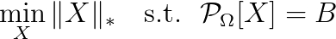
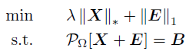
Low-rank Matrix Recovery Models
Matrix Completion:
Matrix Robust Principal Component Analysis (RPCA)
Combined Model

Slide 5
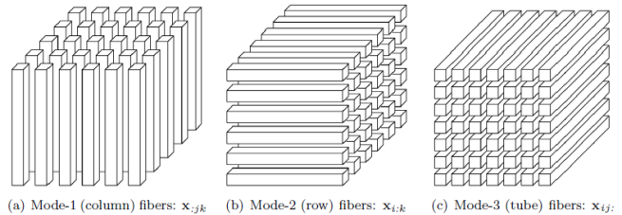
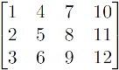
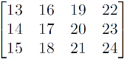
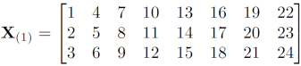
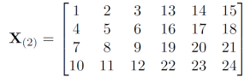
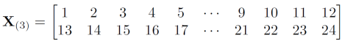
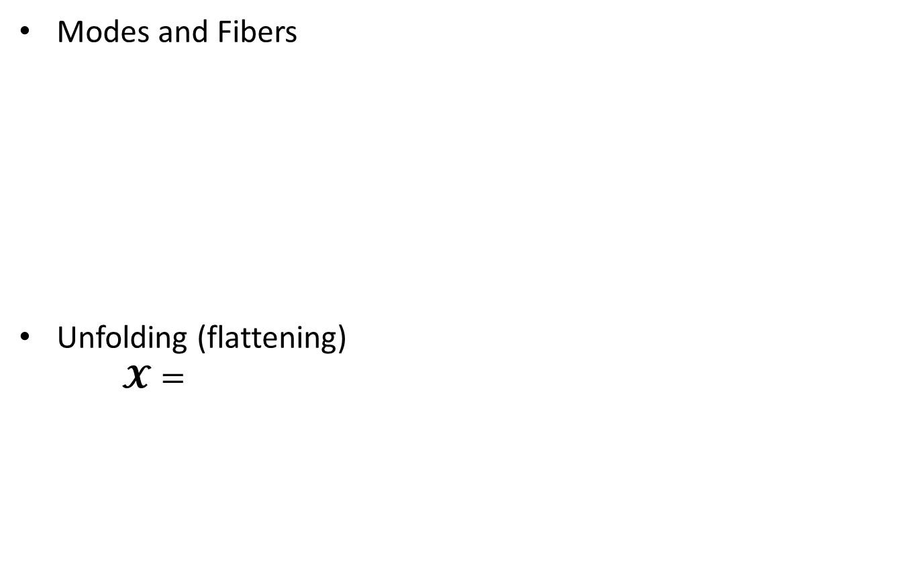
Tensor Basics
Modes and Fibers
Unfolding (flattening)
$$𝓧=$$
(Kolda & Bader, 2009)

Slide 6
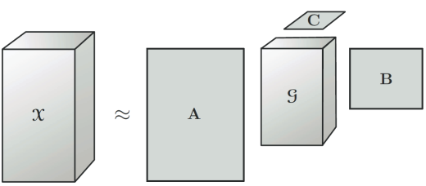
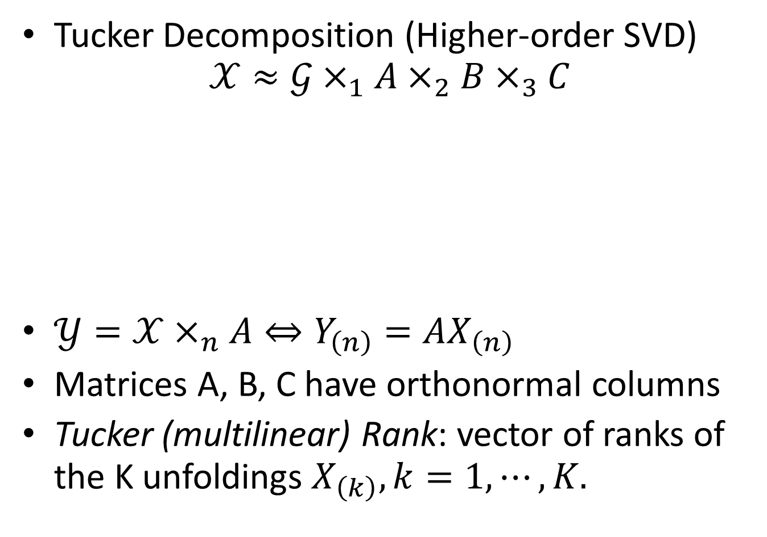
Tensor Decomposition and Rank
Tucker Decomposition (Higher-order SVD) $𝒳≈𝒢×_{1}A×_{2}B×_{3}C$
$𝒴=𝒳×_{n}A⇔Y_{\left(n\right)}=AX_{\left(n\right)}$
Matrices A, B, C have orthonormal columns
Tucker (multilinear) Rank: vector of ranks of the K unfoldings $X_{\left(k\right)},k=1,⋯,K.$

Slide 7
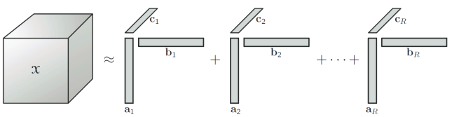
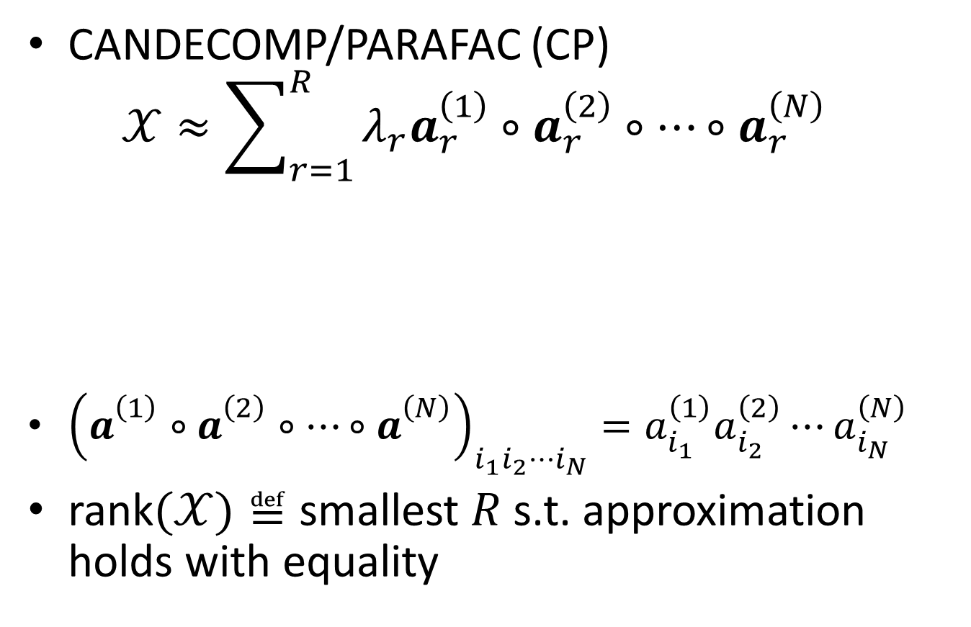
Tensor Decomposition and Rank
CANDECOMP/PARAFAC (CP) $𝒳≈\sum_{r=1}^{R}{λ_{r}a_{r}^{\left(1\right)}∘a_{r}^{\left(2\right)}∘⋯∘a_{r}^{\left(N\right)}}$
${\left(a_{}^{\left(1\right)}∘a_{}^{\left(2\right)}∘⋯∘a_{}^{\left(N\right)}\right)}_{i_{1}i_{2}⋯i_{N}}=a_{i_{1}}^{\left(1\right)}a_{i_{2}}^{\left(2\right)}⋯a_{i_{N}}^{\left(N\right)}$
rank$(𝒳)≝$ smallest $R$ s.t. approximation holds with equality
(Kolda & Bader, 2009)

Slide 8
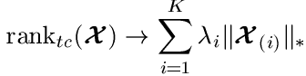
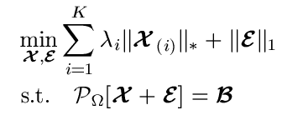
Convex Low-rank Tensor Recovery Model
Sum of Nuclear Norms (SNN)
Convex model with SNN
SNN

Slide 9
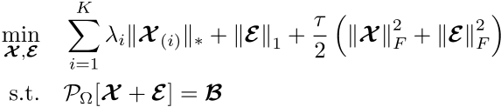
Strongly Convex Low-rank Tensor Recovery Model
Tensor Recovery (TR) model
Strongly convex program when ;
Exact recovery guaranteed when is below a threshold.

Slide 10
Tensor Recovery Guarantees: Sufficient Conditions

Slide 11
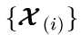
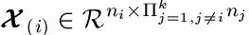
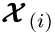
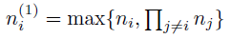
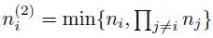
Conditions for Low-rank Tensor Recovery
Minimize sum of nuclear norms for all modes
, where
Do we really need each to be low rank? No!
Tensor exact recovery requires:
One mode (say the k-th) to be low-rank and satisfy an incoherence property;
Other modes need to be incoherent with mode-k on average.
Let and

Slide 12
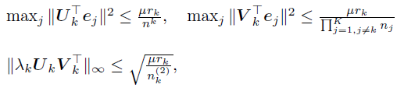
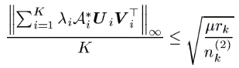
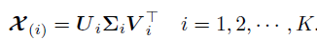
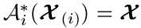
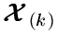
Tensor Incoherence Conditions (TICs)
TICs with parameter : There exists a mode k such that
Standard matrix incoherence condition
Incoherence of other modes w.r.t. mode k
where
The operator converts the i-th unfolding into a tensor, for instance, ;
is the rank of .
Mutual Incoherence (MI)

Slide 13
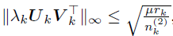
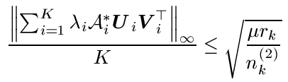
Tensor Incoherence Conditions
Mode-k Incoherence Condition:
Tensor Mutual Incoherence (MI) Condition:
If all modes have low ranks, then the MI condition is satisfied for a smaller .

Slide 14
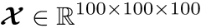
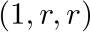
Tensor Incoherence Conditions
The MI condition is not so restrictive in general, but is it necessary?
Yes! Tensor recovery (TR) model does poorly if Tucker ranks are badly unbalanced.
Empirically: randomly generated with Tucker rank

Slide 15
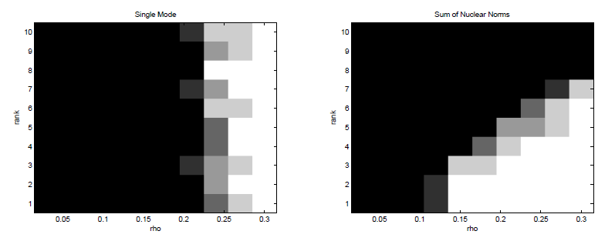
Tensor Incoherence Conditions
Random tensor with Tucker rank (1,r,r)
r: 1 to 10 fraction of entries observed : 0 to 0.3
For each pair : 5 independent trials
Plot the success rate k/5, where k is the number of successful recoveries

Slide 16
Tensor Incoherence Conditions
SNN worse than single mode if r is large
but better if all ranks are low

Slide 17
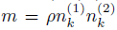
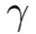
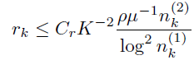
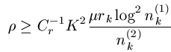
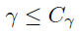
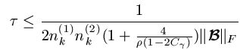
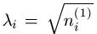
Main Result: Exact Recovery (w.h.p)
Assumptions:
satisfies the TICs with parameter ;
The support set is uniformly distributed with cardinality ;
Each entry is corrupted with probability .
Conditions:
Rank: ( )
Level of corruption:
L2 perturbation:
Parameters:

Slide 18
Tensor Recovery Guarantees: Lower Measurement Bounds

Slide 19
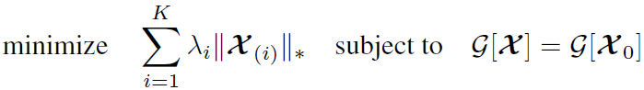
Low-rank tensor recovery under the random Gaussian measurements
Vector (non-convex) model
The Sum of Nuclear Norms (SNN) model
Lower measurement bound: The least number of random Gaussian measurements needed for exact recovery.

Slide 20
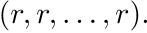
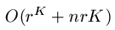
Lower Measurement Bounds for Exact Recovery
For simplicity, consider the K-way tensor of length and Tucker rank
Lower measurement bounds: (Mu, H., W., G., ’13)
Non-convex:
SNN:
For K>2, there is a big gap when the ratio
is large!

Slide 21
Square Deal: A better Convexification

Slide 22
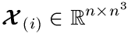
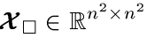
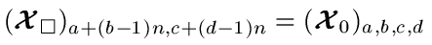
Square Deal: new convex objective
Square Deal: An improved convex surrogate for the Tucker rank.
When K=4, instead of unfolding into a flat matrix, i.e., , reshape it into a square matrix , i.e.,
Same idea applies when K>4: make as “square” as possible.

Slide 23
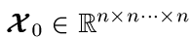
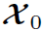
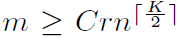
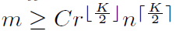
Square Deal: Main results
Theorem: For a K-way tensor ,
If has CP rank r, using Square Deal,
Gaussian measurements are sufficient to recover ;
(2) If has Tucker rank (r…r), then at least
Gaussian measurements are sufficient to recover .

Slide 24
Square Deal
Significant improvement when K>4 and r is small
Still suboptimal compared to the non-convex model

Slide 25
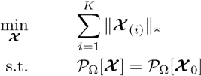
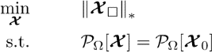


Square Deal For Tensor Completion
Yes! (Empirically)

Slide 26
Convex Algorithms: Alternating Direction Augmented Lagrangian (ADAL) method (ADMM method)

Slide 27




Variable Splitting
$$\sum_{i}{{λi\left\|𝓧_{(i)}\right\|}_{∗}}$$
$$𝒳$$
$$\begin{matrix}𝒳_{1} & = & 𝒳_{2}\end{matrix}\begin{matrix} = & ⋯ & 𝒳_{N}\end{matrix}$$
$${\sum_{i}{{λi\left\|𝓧_{i,\left(i\right)}\right\|}_{∗}}}$$
$$𝒳_{i}=W i=1,⋯,N$$

Slide 28




ADAL for T-RPCA
Augmented Lagrangian (AL) for T-RPCA
Hard to minimize AL w.r.t. and . simultaneously! Use alternating directions.

Slide 29

ADAL
Replace by individual minimizations:
Each sub-problem is a simple shrinkage operation!

Slide 30




Step 1: X-subproblem:
where is the matrix singular value soft-threshold:
Step 2: E-subproblem:
where
Lasso shrinkage operation, simple!

Slide 31

Empirical Recoverability
Random tensors (50, 50, 20), rank-(5,5,5)
10% data corrupted, varying % observations…

Slide 32

Empirical Recoverability
Random tensors (50, 50, 20), rank-(5,5,5)
Full observation, varying % corruption…

Slide 33
Convex Algorithms: Ultra-fast First-Order Method

Slide 34

Low-rank and sparse demixing problem

Slide 35
Stable Principal Component Pursuit (SPCP)
Computer vision
Video background modelling [CLMW ‘11]
Face verification [ZMKW ’13]
Photometric stereo [WGS+ ‘11]
Dynamic MRI [OCS ‘13]
Statistics
Outlier detection / robust Principal Component Analysis [CLMW ‘11]
Latent variable graphical model learning [CPW ‘12]
Document analysis
Topic modelling [MZWM ‘10]

Slide 36

Algorithms for SPCP
Many first-order methods have been developed
Most exploit the closed-form expression for the proximal operator of nuclear norm
Most use full or partial SVD, thus limits their applicability to large-scale problem
Is it possible to design a linear iteration-cost algorithm?

Slide 37


Frank-Wolfe Algorithm
Solve
: Compact and convex
: Convex and differentiable with L-Lipschitz gradient
Frank-Wolfe algorithm

Slide 38

Frank-Wolfe for Norm-Constrained SPCP
Solve
Frank-Wolfe algorithm for SPCP:

Slide 39



Inefficiency of the FW algorithm
Synthetic data: (Slow convergence)
Inefficient in updating :

Slide 40

Ultra-Fast Frank-Wolfe Algorithm
Key idea: Add a prox gradient step to update S after each F-W step.

Slide 41




Ultra-Fast Algorithm (UFA) for SPCP
Solve
Domain unbounded → Epigraph Reform.!

Slide 42



Ultra-Fast Algorithm For SPCP
Synthetic data: (Red: F-W, Blue: UFA)

Slide 43

Ultra-Fast Algorithm For SPCP
Comparison with other algorithms

Slide 44

UFA For Matrix SPCP
Background and foreground extractions from greyscale surveillance videos
each frame stacked as a column in
background
foreground
96 seconds using a laptop!

Slide 45


UFW For Tensor SPCP
Convex program:
sparse tensor
4-way tensor color video
low-rank tensor

Slide 46

UFA For Tensor SPCP
Background segmentation for color videos:
background modelling (50% missing entries)
Data size: 128 x 160 x 3 x 300 = 18.4M Run time: 34 secs.

Slide 47




Thanks to…
References:
Square Deal: Lower Bounds and Improved Relaxations for Tensor Recovery Mu, Huang, Wright, Goldfarb, ‘13
Provable Low-rank Tensor Recovery Huang, Mu, Wright, Goldfarb, ‘14
Fast Algorithms for Stable Robust Principal Component Pursuit via Frank-Wolfe Mu, Wright, Goldfarb, ’14
Robust Low-rank Tensor Recovery: Models and Algorithms Qin, G., ‘12

Slide 48

Tensor Incoherence Conditions

